Slide 1


Kong API GATEWAY
Course by Arnab Das

Slide 2

Description
Kong API Gateway is a cloud-native, high-performance API gateway designed for microservices and distributed architectures. It acts as a reverse proxy, managing, configuring, and routing requests to your APIs. Here’s what makes Kong API Gateway stand out:
Lightweight and Fast: Optimized for low latency and high throughput, handling thousands of transactions per second.
Flexible and Extensible: Can be extended through modules and plugins to add additional functionality.
Hybrid and Multi-Cloud: Runs on decentralized architectures, including hybrid-cloud and multi-cloud deployments.
Automation and GitOps: Supports workflow automation and modern GitOps practices for efficient operations.
Security and Governance: Provides tools to secure and govern APIs, improving visibility and control across the organization.
Kong Gateway is distributed with OpenResty, which extends the lua-nginx-module, allowing for a modular architecture where plugins can be enabled and executed at runtime.

Slide 3
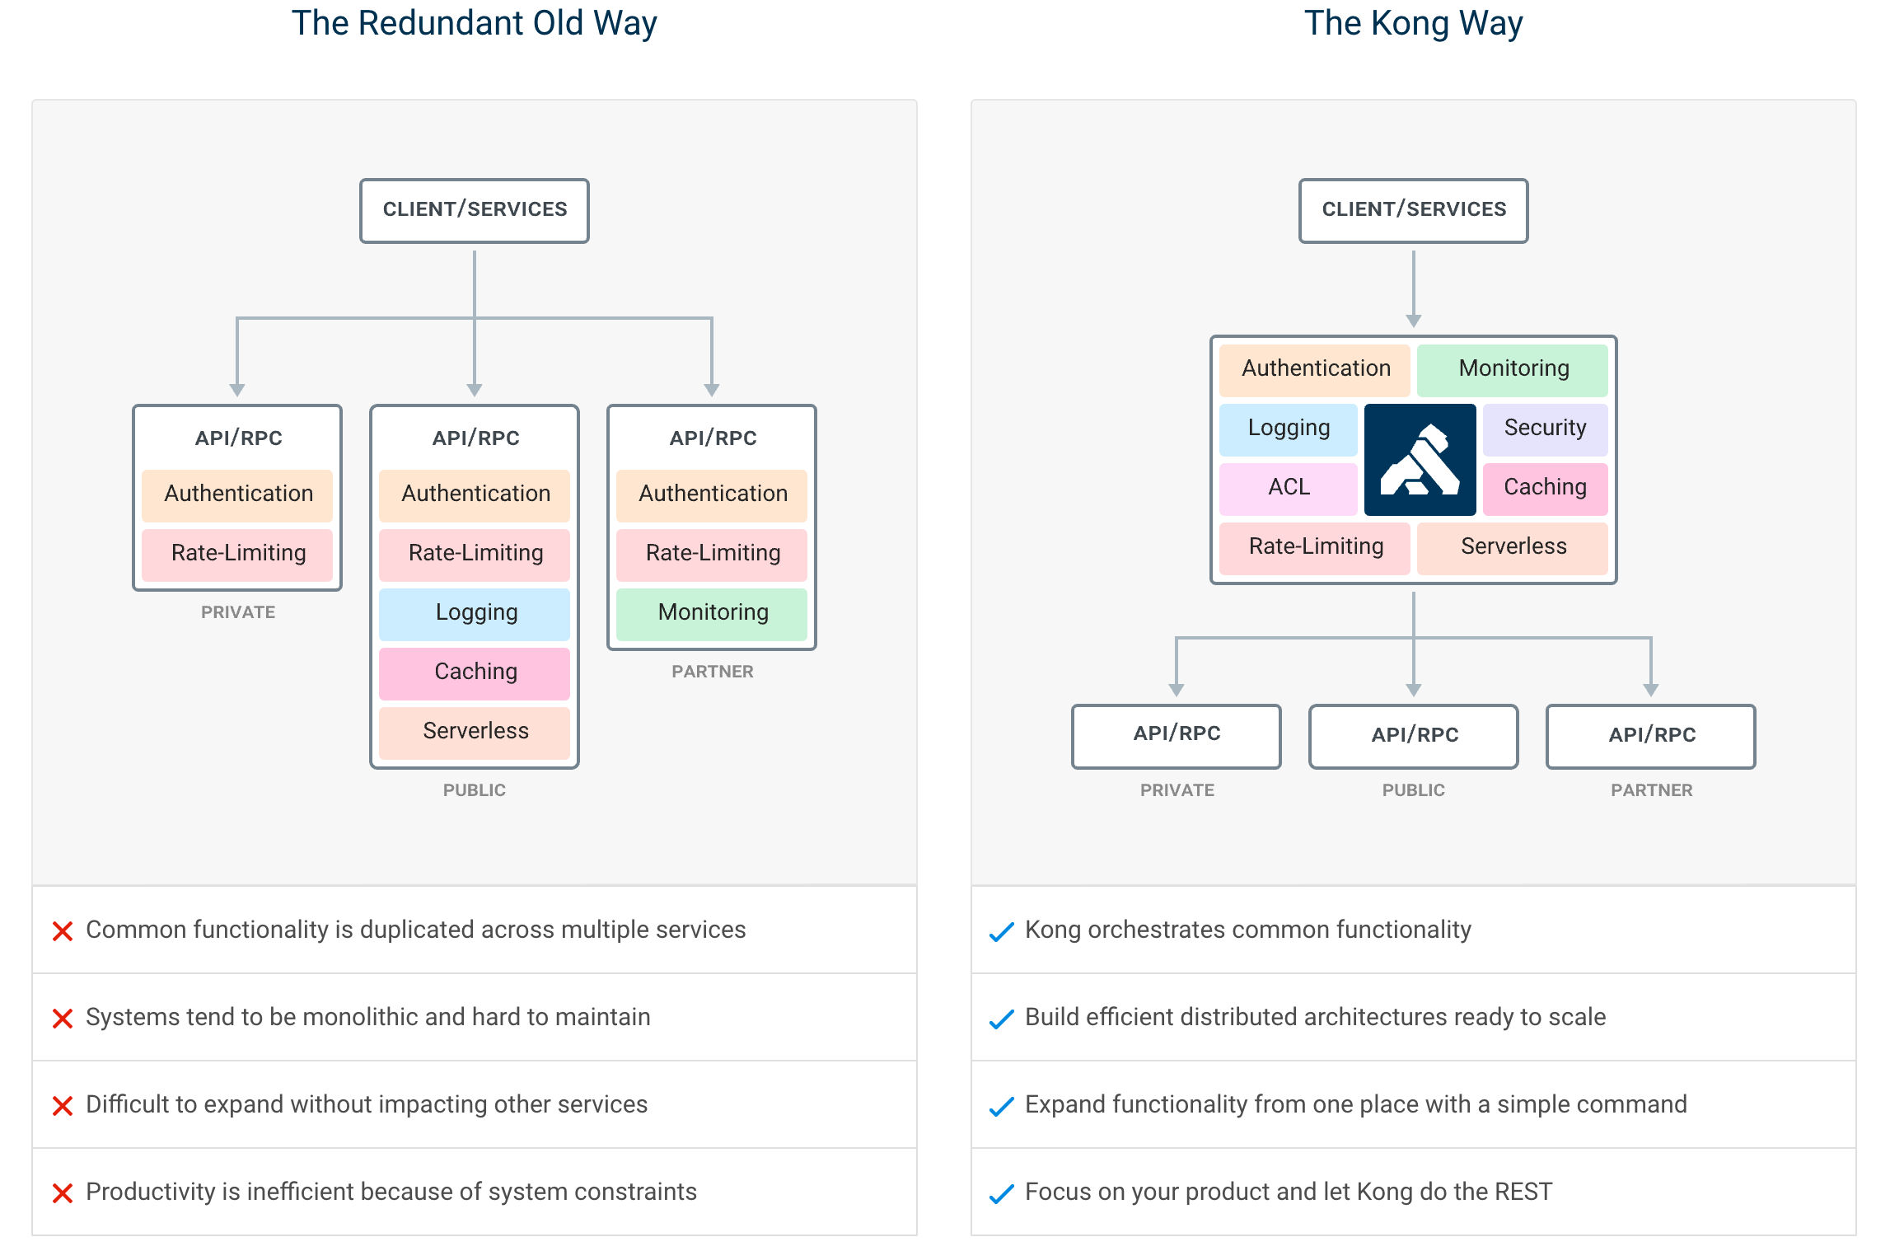

Slide 4

Course Outline
01
02
03
04
05
Lesson
Lesson
Lesson
Lesson
Lesson
Installation
Kong Usage
Kong Admin API
Kong Plugins
Extending Kong Plugins

Slide 5

01
lesson
Installation

Slide 6

lesson outline
Topic 1: Install Kong
Topic 2: Create a Dummy API End Point
Topic 3: Kong Manager
Topic 4: Kong Admin API
​
Topic 5: Konga

Slide 7


API Endpoint Using FastAPI (Optional)

Slide 8


How to Use Postman?

Slide 9
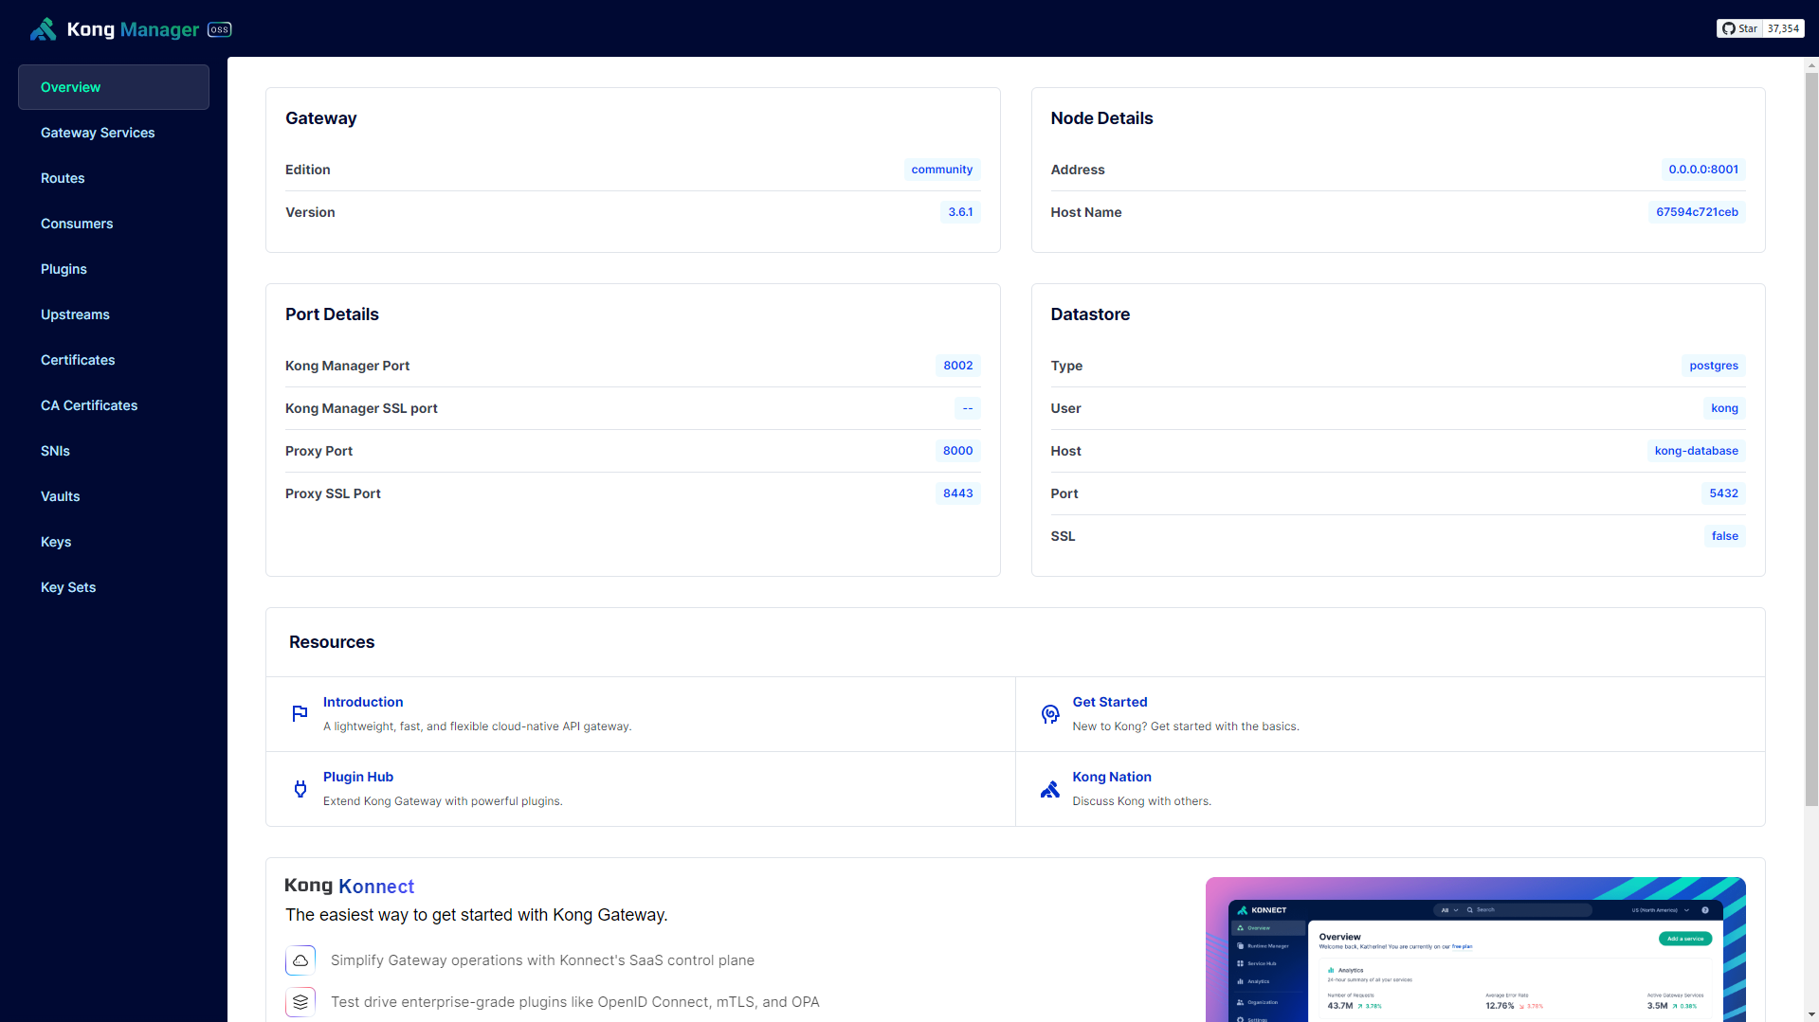

Kong Manager

Slide 10
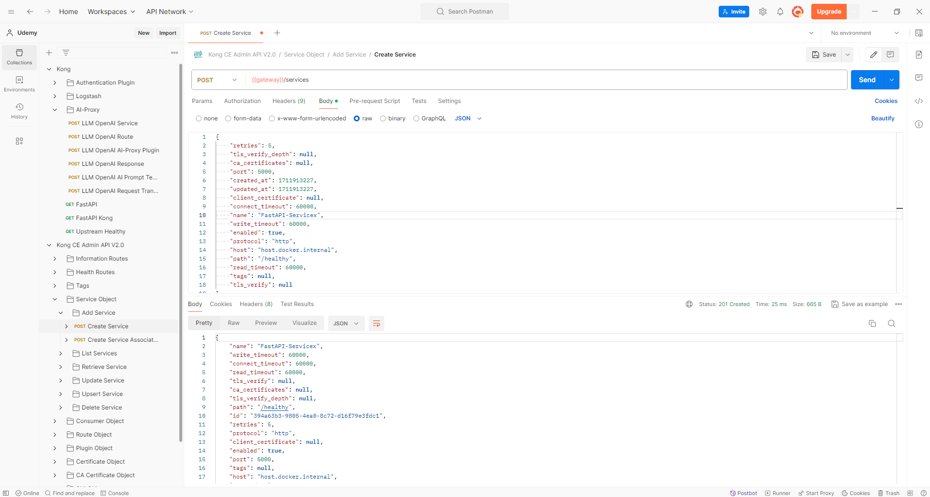

Kong Admin API

Slide 11

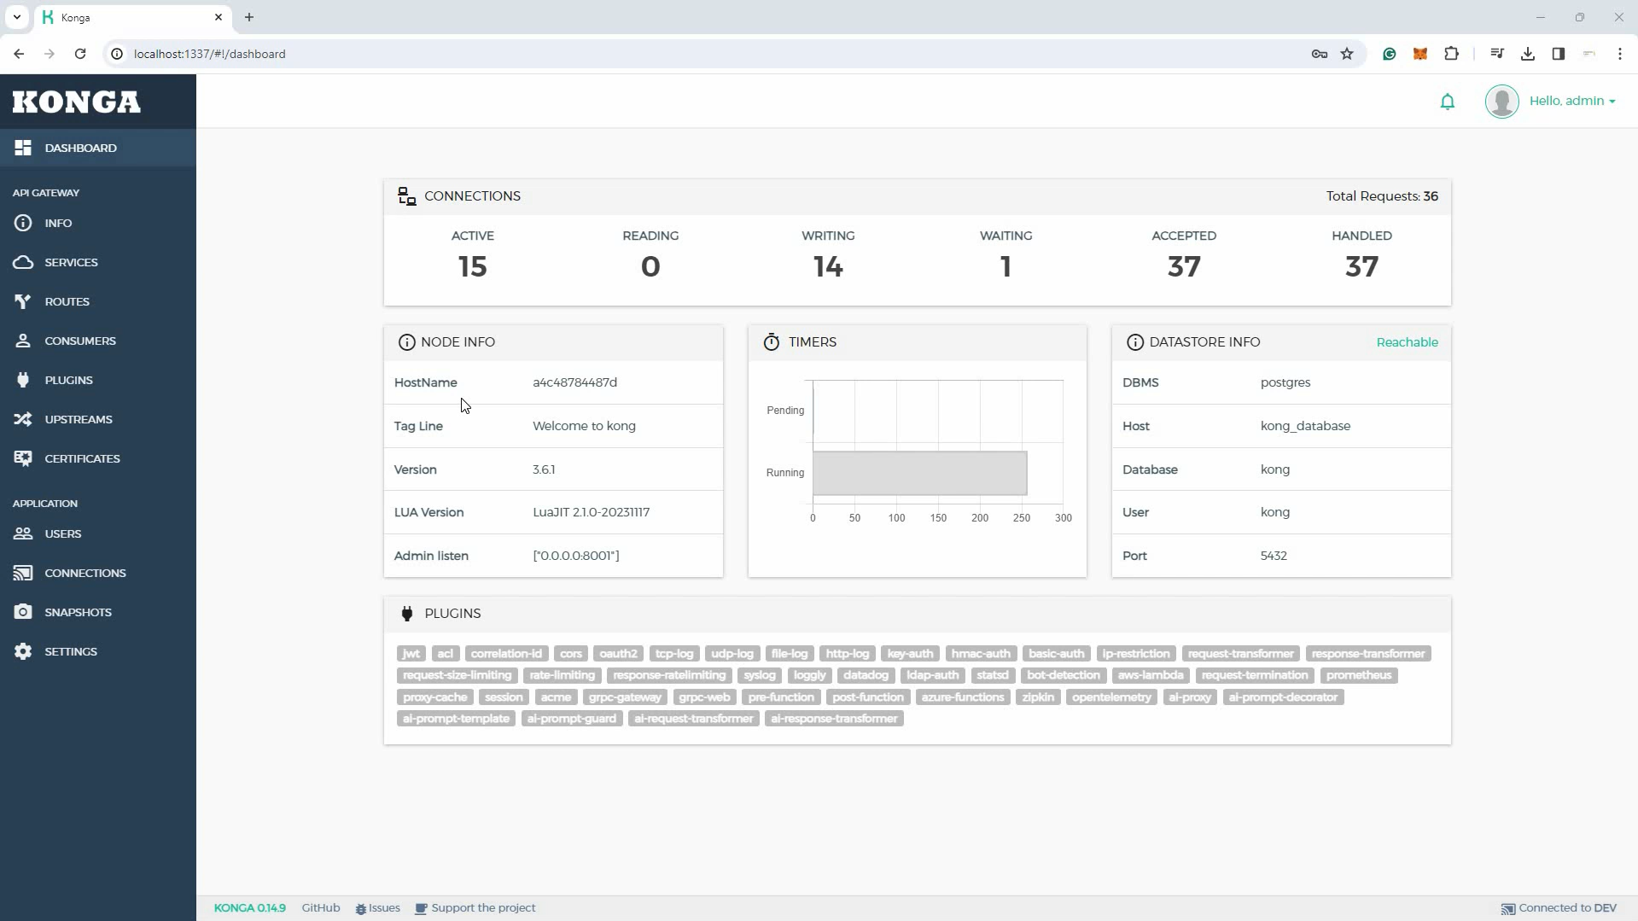
Konga

Slide 12

04
lesson
Kong Plugins

Slide 13

Kong Plugins
Authentication
Security
Traffic Control
Analytics & Monitoring Plugin
Transformations
Logging
Let’s you add API key authentication to a service or a route.
Enables security to protect API against unauthorized access.
Restrict inbound and outbound API traffic.
Monitor health of API
Transform API requests and responses
Log HTTP request and response data in JSON

Slide 14

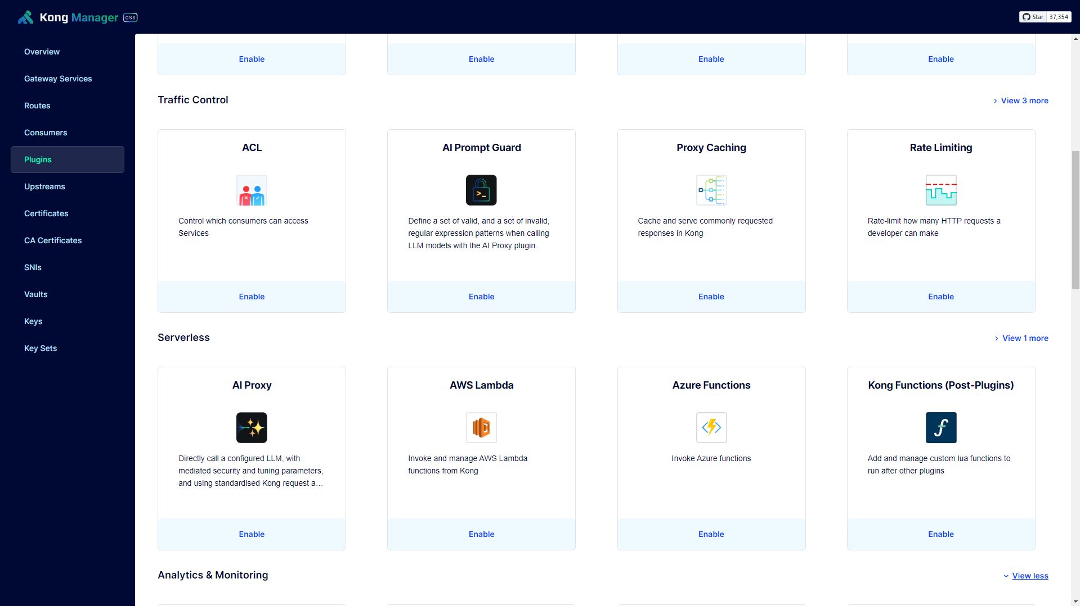
PLUGINS

Slide 15
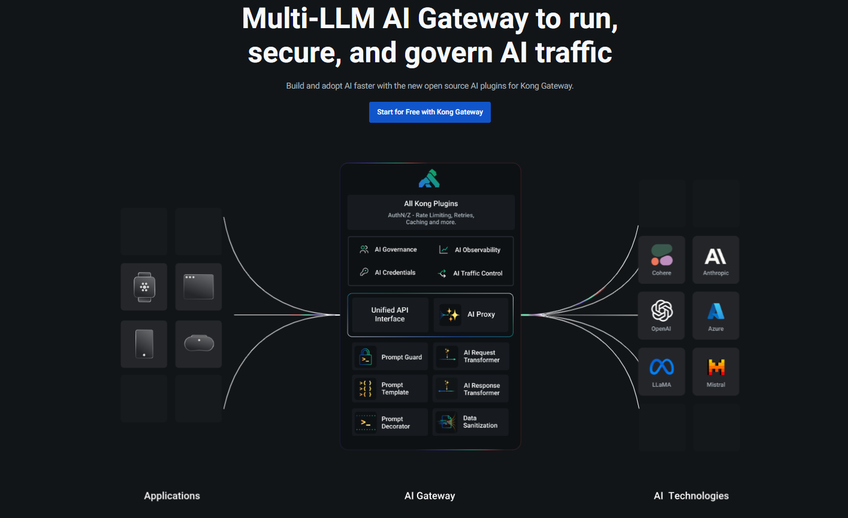

Slide 16


05
lesson
Kong Custom Plugins with Lua

Slide 17
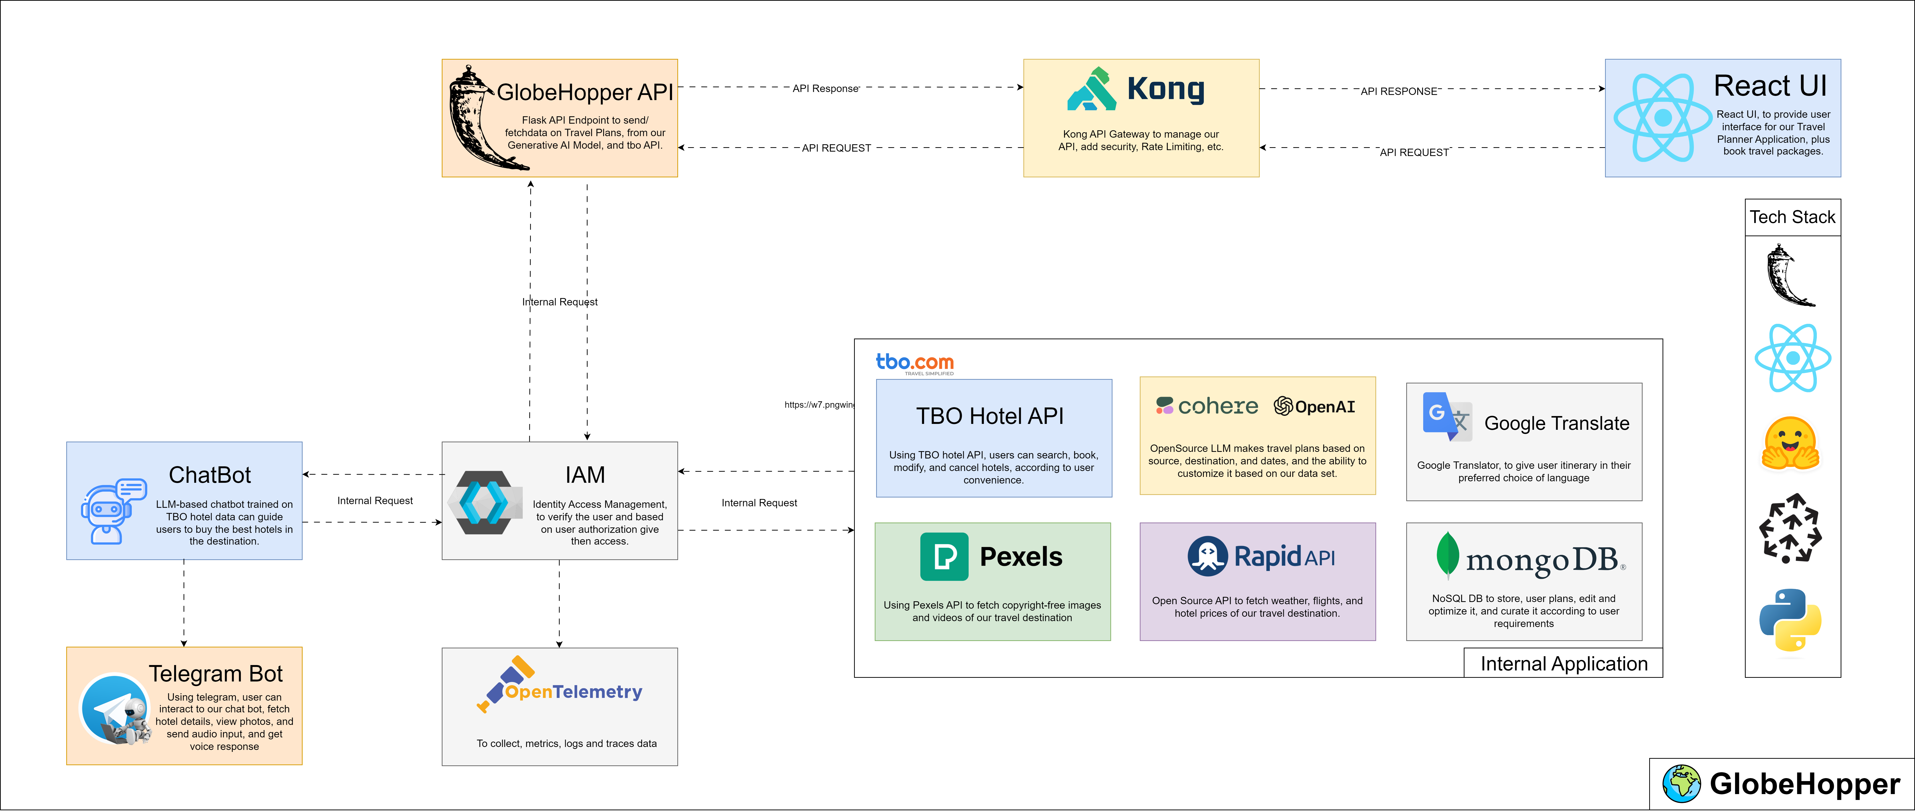

Slide 18
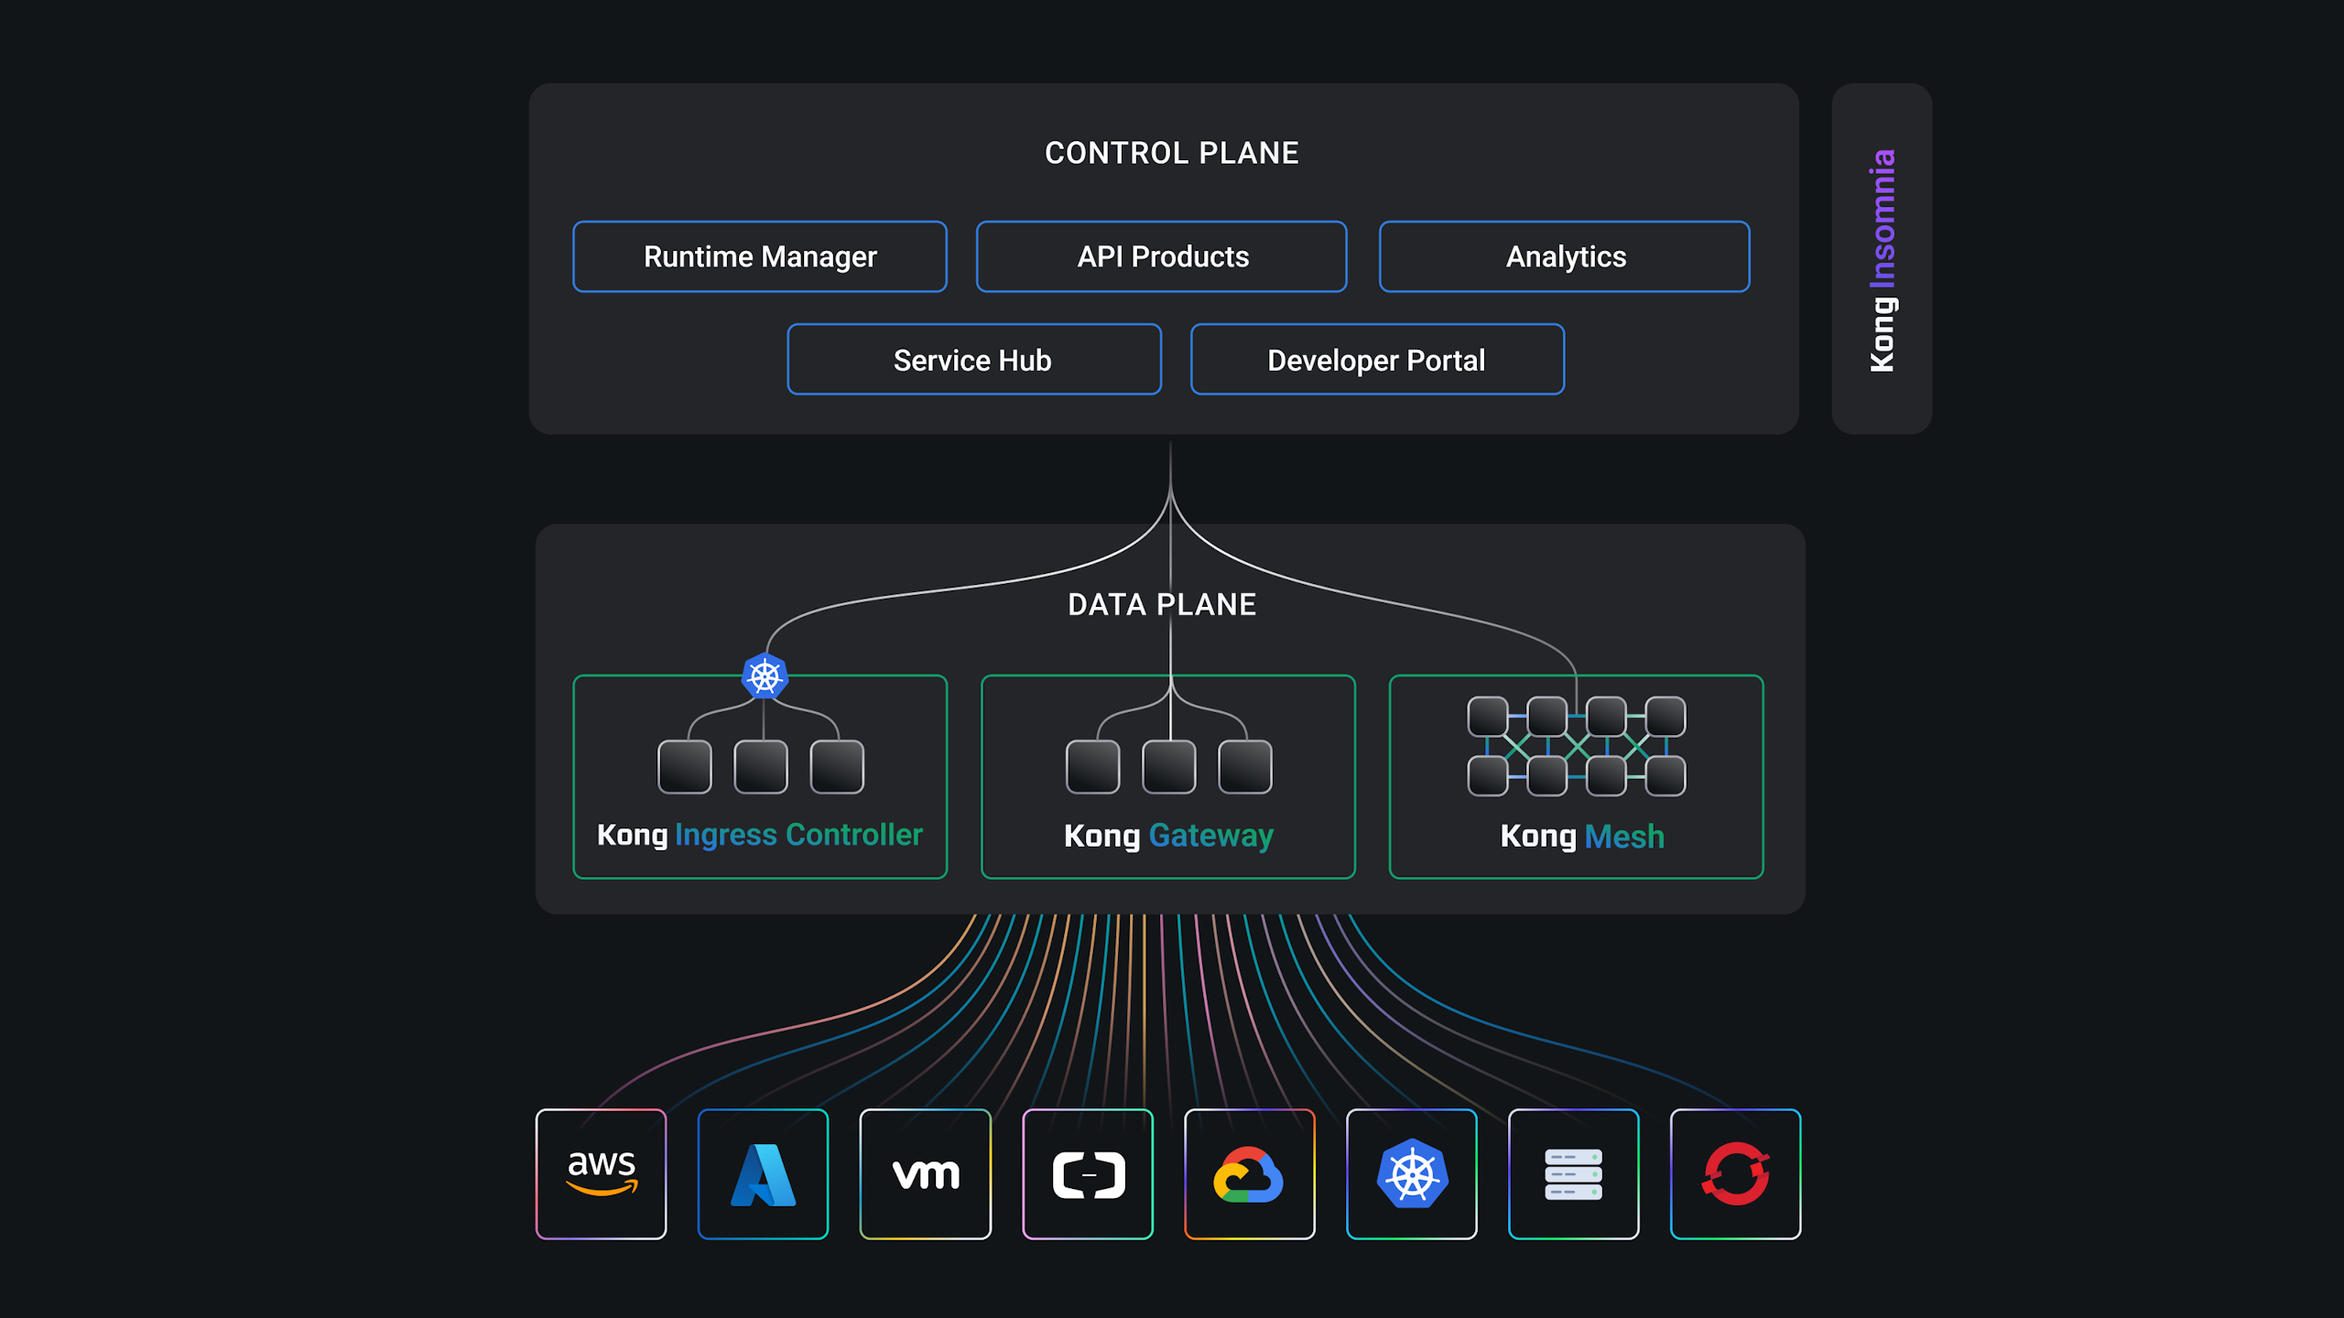

Slide 19

THANK YOU
Arnab Das
raj713335@gmail.com
https://www.linkedin.com/in/raj713335/

